Slide 1
CHAPTER NO. 4
TRANSPORT LAYER.
Compiled by: Savita C.Raut

Slide 2
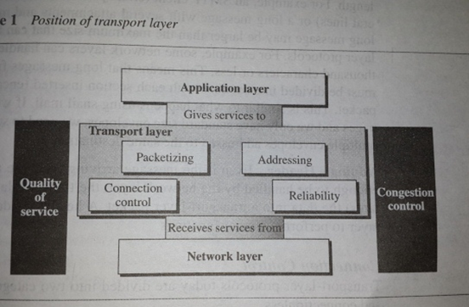

Slide 3
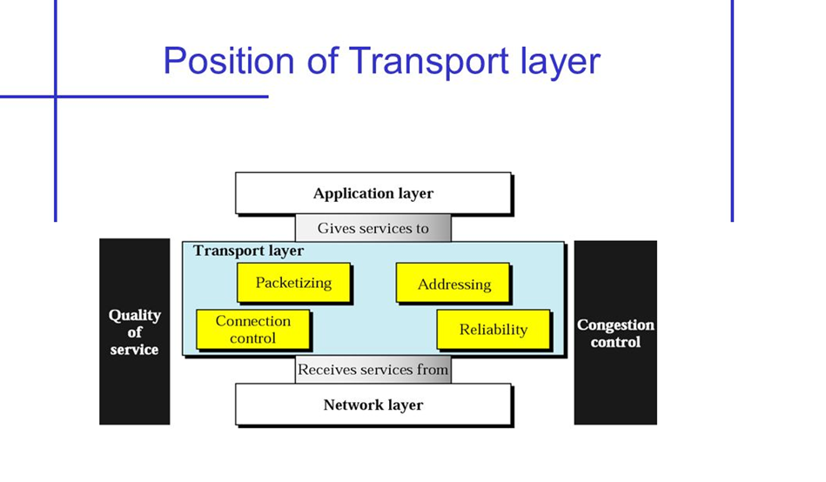

Slide 4
Packetizing:
It creates packets out of message received from the application layer.
It divides long messages into smaller ones; these smaller units are encapsulated into the data field of the transport-layer packet and headers are added.
DIVIDING LARGE MESSAGES:
The message an application program sends can vary in length.
Eg. A SMTP client (email protocol) may send a short message or a long message with several attachments and multimedia documents.

Slide 5
ADDING A HEADER:
Even if the message arriving from the application layer is small enough to be handled by the network layer, the transport layer still inserts (encapsulates) the data into a transport-layer packet.
A header is added to allow the transport layer to perform its other functions.
CONNECTION CONTROL:
It is divided into two categories :
Connection-oriented and Connection less.

Slide 6
Connection –Oriented delivery :
A connection oriented transport layer protocol first establishes a connection (a virtual path ) between the sender and receiver.
The connection is virtual; that is, the application layer perceives that a single path has been created; in reality, the packets may travel through different physical paths.
A session exists between the sender and the receiver.
The session remains intact until it is broken by one of the parties.

Slide 7
In the meantime, the two parties can send multiple packets related to each other, traveling one after another through the virtual path.
Of course the packet may travel out of order, but the transport layer ensures that this is transparent to the application program.
The packets are numbered consecutively and communication can take place in both directions.

Slide 8
CONNECTIONLESS DELIVERY :
It treats each packet independently without any connection between them.
ADDRESSING :
A server machine provides the service of HTTP, SMTP, POP and TELNET.
When the request arrives from the client to the remote server for HTTP, the computer must deliver the request to the HTTP server program, and not to any other server program.
In other words, the packet carrying the request must specify to which server program the request must be delivered.
The request packet must also specify the client program that sent the packet.
The server uses this, when it responds to the request.

Slide 9
When we need to deliver something to one specific destination among many, we need an address.
At the data link layer, we need a MAC address to choose one node among several nodes.
At the network layer, we need an IP address to choose one host among millions.
At the transport layer, we need a transport-layer address, called a port number, to choose among multiple processes running on the destination host.
The destination port number is needed for delivery; the source port number is needed for the reply.

Slide 10
In the internet model, the port numbers are 16 bit integers between ‘0’ and ‘65535’.
The client program defines itself with a port number, chosen randomly by the transport layer software running on the client host.
This is the ephemeral port number.
The server process must also define itself with a port number.
The internet has decided to use universal port numbers for servers; these are called well-known port numbers.
IP address and port numbers play a different role in selecting the final destination of data.
Depending upon an IP address, the host has been selected, the port number defines one of the processes on this particular host.

Slide 11
IANA Ranges : [ Internet assigned number authority]
Is has divided the port numbers into three ranges :
1. Well-known ports : The ports ranging from 0 to 1023 are assigned and controlled by IANA. These are well known ports.
2. Registered ports : The ports ranging from 1024 to 49151 are not assigned or controlled by IANA.
3. Dynamic ports : the ports ranging from 49152 to 65535 are neither controlled nor registered. They can be used by any process. These are ephemeral ports.

Slide 12
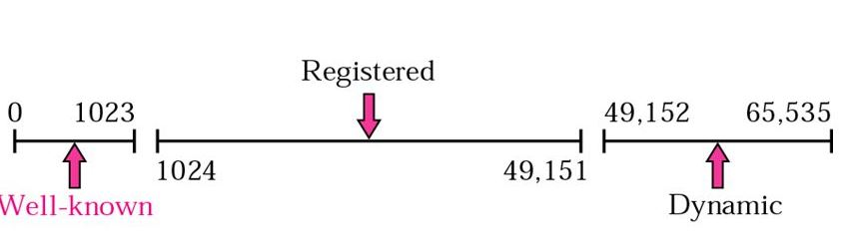
IANA Range :

Slide 13
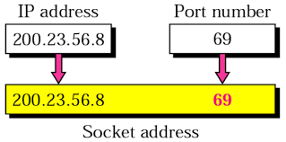
Socket Addresses :
Process – to – process delivery needs two identifiers, IP address and the port number, at each end to make a connection. The combination of an IP address and a port number is called socket address. The client socket address defines the client process uniquely just as the server socket address defines the server process uniquely.
A transport-layer protocol needs a pair of socket addresses : the client socket address and the server socket address. These four pieces of information are part of the IP header and the transport-layer protocol header. The IP header contains the IP addresses; the UDP or TCP header contains the port numbers.

Slide 14
PROVIDING RELIABILITY:
A transport layer can provide reliability for the application program that uses its services. ( as it involves flow control and error control )
FLOW CONTROL:
The transport layer can provide flow control. ( just like data link layer ).
However, flow control at this layer is performed end to end rather than across a single link.

Slide 15
ERROR CONTROL :
It can provide error control. (like data link layer).
However error control at this layer is performed end to end rather than across a single link.
The sending transport layer makes sure that the entire message arrives at the receiving transport layer without error.( damage, loss or duplication).
Error correction is usually achieved through retransmission.

Slide 16
CONGESTION CONTROL AND QoS:
Although Congestion in the network can happen in the data link, network, or transport layer, the effect of the congestion is normally seen in the transport layer because this is the layer that directly gives services to the application layer.
The transport layer is responsible for process-to-process delivery.

Slide 17
PROCESS-TO-PROCESS DELIVERY :
The data link layer is responsible for delivery of frames between two neighboring nodes over a link.
This is called node-to-node delivery.
The network layer is responsible for delivery of datagrams between two hosts.
This is called host-to-host delivery.
Communication on the internet is not defined as the exchange of data between two nodes or between two hosts.
Real communication takes place between two processes (application programs).
We need process-to-process delivery.

Slide 18
However, at any moment, several processes may be running on the source host and several on the destination host.
The transport layer protocol is responsible for process-to-process delivery, the delivery of a packet, part of a message, from one process to another.
Two processes communicate in a client-server relationship.

Slide 19
Client-Server Paradigm:
A process on the local host, called a client, needs services from a process usually on the remote host, called a server.
Both process ( client and server) have the same name.
For eg., to get the day and time from a remote machine, we need a Daytime client process running on the local host and a Daytime server process running on a remote machine.
Operating system today support both multiuser and multiprogramming environments.
A remote computer can run several server programs at the same time, just as local computers can run one or more client programs at the same time.

Slide 20
Addressing :
At the data link layer, we need a MAC address to choose one node among several nodes, if the connection is not point to point.
At the network layer, an IP address is needed to choose one host among millions .
A datagram in the network layer needs a destination IP address for delivery and a source IP address for the destinations reply.
At the transport layer, we need a transport-layer address, called a port number, to choose among multiple processes running on the destination host.
The destination port number is needed for delivery; the source port number is needed to the reply.
In the internet model, the port numbers are 16-bit integers, between ‘0’ & 65535. The client program defines itself with a port number, chosen randomly by the transport layer software running on the client host. This is ephemeral port number.

Slide 21
The server process must also define itself with a port number. This port number, however, cannot be chosen randomly.
The internet has decided to use universal port numbers for servers; these are called well-known port numbers.

Slide 22
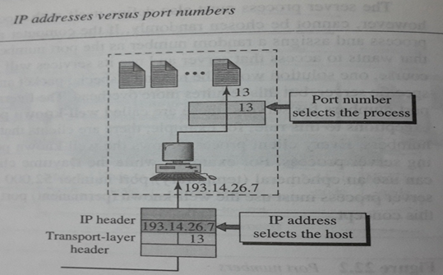

Slide 23
A transport-layer protocol needs a pair of socket addresses : the client socket address and the server socket address. These four pieces of information are part of the IP header and the transport-layer protocol header. The IP header contains the IP addresses; the UDP or TCP header contains the port numbers.

Slide 24
Connectionless versus Connection-oriented Service:
A transport-layer protocol can either be connectionless or connection-oriented.
Connectionless Service :
In a connectionless service, the packets are sent from one party to another with no connection established between them.
The packets are not numbered; they may be delayed, lost, or arrive out of sequence.
There is no acknowledgment either.
One of the transport layer protocol in the internet model , UDP is connectionless.

Slide 25
Connection-Oriented Services :
In this, a connection is first established between the sender and the receiver.
Data are transferred.
At the end, the connection is released.
Transport layer in the internet model, has TCP, which is connection oriented protocol.

Slide 26
Reliable versus Unreliable:
The Transport-layer services can be reliable or unreliable.
If the application-layer program needs reliability, we use a reliable transport-layer protocol by implementing flow and error control at the transport layer.
This means a slower and more complex service.
On the other hand, if the application program does not need reliability because it uses its own flow and error control mechanism or it needs fast service or the nature of the service does not demand flow and error control ( real time applications), then an unreliable protocol can be used.
In the internet there are two different Transport layer protocols:
UDP is connectionless and unreliable; and TCP is connection-oriented and reliable.
These two can respond to the demands of the application layer programs.

Slide 27
USER DATAGRAM PROTOCOL ( UDP ) :
It is a connectionless, unreliable transport protocol.
It does not add anything to the services of IP except for providing process-to-process communication instead of host-to-host communication.
There is no flow control mechanism and three is no acknowledgment for received packets.
If UDP detects an error in the received packet, it silently drops it.
If UDP is so powerless, why would a process want to use it ?
With the disadvantages, come some advantages.
UDP is a very simple protocol using a minimum of overhead.
If a process wants to send a small message and does not care much about reliability, it can use UDP.
Sending a small message using UDP takes much less interaction between the sender and receiver than using TCP.

Slide 28
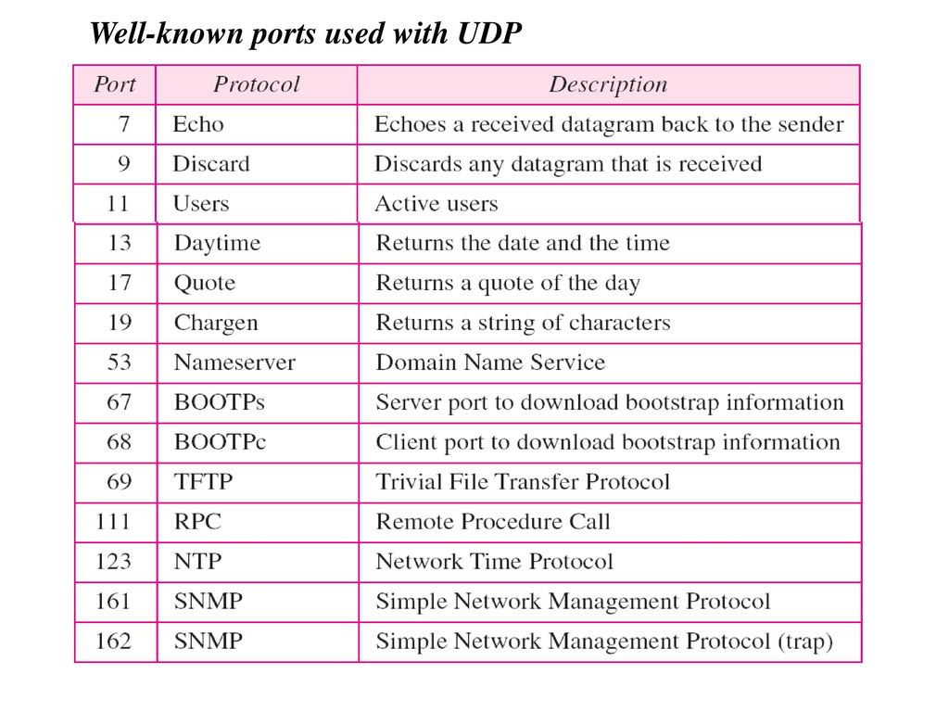

Slide 29
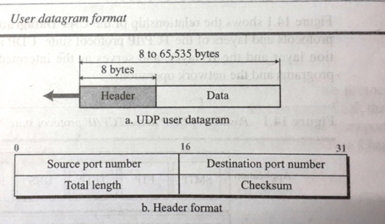
USER DATAGRAM :
UDP packets called datagrams, have a fixed size header of 8 bytes.

Slide 30
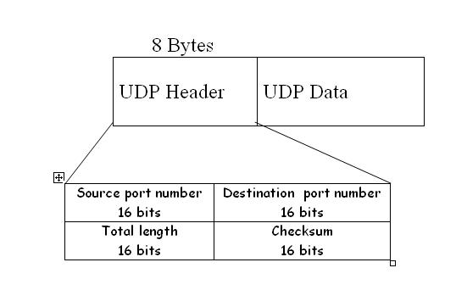

Slide 31
Source port number : This is the port number used by the process running on the source host.
It is 16 bits long, which means that the port number can range from 0 to 65535.
Destination port number: This is the port number used by the process running on the destination host.
It is also 16 bits long.
Length : This is a 16-bit field that defines the total length of the user datagram, header plus data.
The 16 bits can define a total length of 0 to 65535 bytes.
A user datagram is encapsulated in an IP datagram.
There is a field in the IP datagram, that defines the total length.

Slide 32
Checksum : This field is used to detect errors over the entire user datagram ( header plus data ).
The calculation of checksum and its inclusion in a user datagram are optional. If the checksum is not calculated, the field is filled with 0’s.

Slide 33
11.3 CHECKSUM
UDP checksum calculation is different from the one for IP and ICMP. Here the checksum includes three sections: a pseudoheader, the UDP header, and the data coming from the application layer.

Slide 34
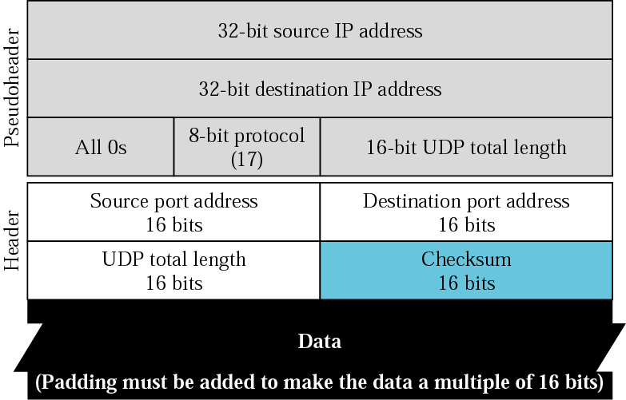
Figure 11.8 Pseudoheader for checksum calculation

Slide 35
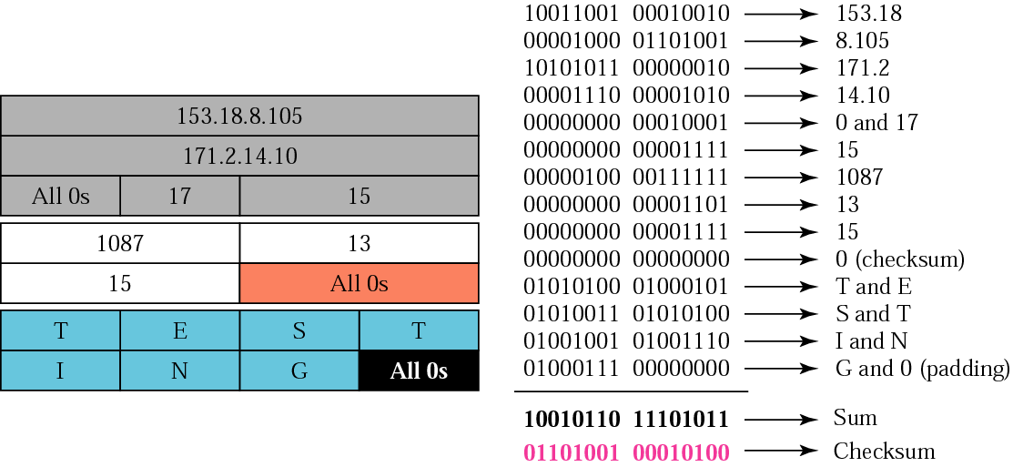
Figure 11.9 Checksum calculation of a simple UDP user datagram

Slide 36
Example : A dump UDP header in hexadecimal format.
CB84,000D,001C,001C
Source port no. ( CB84 ₁₆ ) = 52100.
Destination port no. ( 000d ₁₆ ) = 13.
Total length of user datagram. ( 001C ₁₆ ) = 28 bytes.
Length of data : 28 – 8 = 20 bytes.
Destination port is 13 : the packet is from client to server.
The client process is the : Daytime.

Slide 37
One Question : The data link layer is reliable and has flow and error control, do we need this at the transport layer, too?
Answer is Yes. Reliability at the data link layer is between two nodes; we need reliability between two ends.
Because the network layer in the internet is unreliable (best-effort-delivery), we need to implement reliability at the transport layer.
To understand that error control at the data link layer does not guarantee error control at the transport layer will be cleared by the given figure given below :

Slide 38
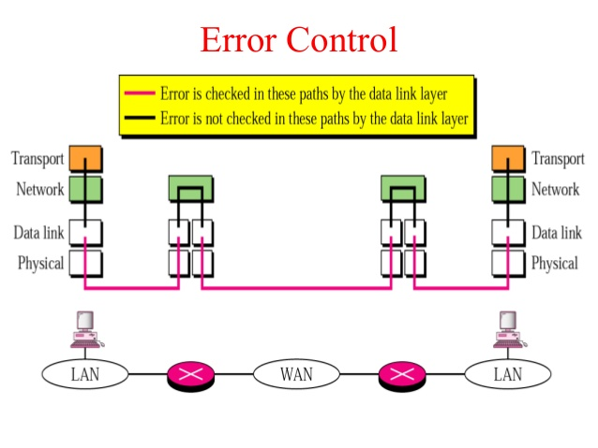

Slide 39
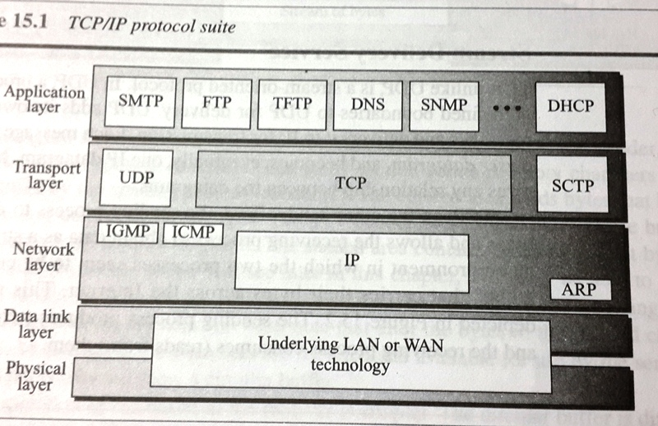
TRANSMISSIOIN CONTROL PROTOCOL (TCP) :

Slide 40
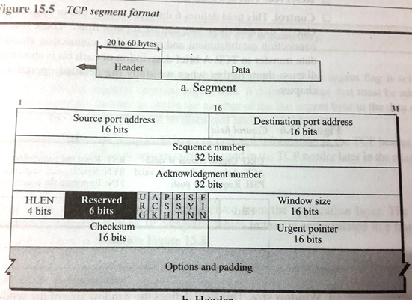

Slide 41
The segment consists of a 20 to 60 byte header, followed by data from the application program.
The header is 20 bytes, if there are no options and up to 60 bytes, if it contains options.
Source port address :
This is a 16-bit field that defines the port number of the application program in the host that is sending the segment.
Destination port address : This is a 16-bit field that defines the port number of the application program in the host that is receiving the segment.

Slide 42
Sequence number :
This 32-bit field defines the number assigned to the first byte of data contained in this segment.
As it is said before, TCP; is a stream transport protocol.
To ensure connectivity, each byte to be transmitted is numbered.
The sequence number tells the destination which byte in this sequence is the first byte in the segment.
During connection establishment each party uses a random number generator to create an initial sequence number (ISN), which is usually different in each direction.

Slide 43
Acknowledgement number :
This 32-bit field defines the byte number that the receiver of the segment is expecting to receive from the other party.
If the receiver of the segment has successfully received byte number x from the other party, it returns x+1 as the acknowledgment number.
Acknowledgment and data can be piggybacked together.
Header length :
The 4-bit field indicates the number of 4-byte words in the TCP header.
The length of the header can be between 20 and 60 bytes.
Therefore, the value of this field is always between 5 ( 5 x 4 = 20 ) and ( 15 x 4 = 60 ).

Slide 44
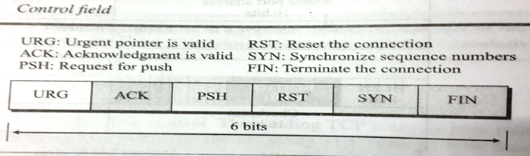

Slide 45
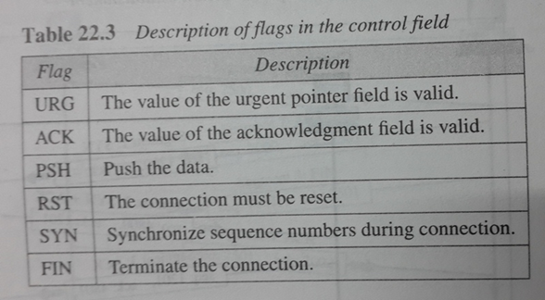

Slide 46
TCP Flags
Synchronization (SYN) – It is used in first step of connection establishment phase or 3-way handshake process between the two hosts. Only the first packet from sender as well as receiver should have this flag set. This is used for synchronizing sequence number i.e. to tell the other end which sequence number they should accept.
Acknowledgement (ACK) – It is used to acknowledge packets which are successful received by the host. The flag is set if the acknowledgement number field contains a valid acknowledgement number.
In given below diagram, the receiver sends an ACK = 1 as well as SYN = 1 in the second step of connection establishment to tell sender that it received its initial packet.

Slide 47
TCP Flags
Finish (FIN) – It is used to request for connection termination i.e. when there is no more data from the sender, it requests for connection termination. This is the last packet sent by sender. It frees the reserved resources and gracefully terminate the connection.
Reset (RST) – It is used to terminate the connection if the RST sender feels something is wrong with the TCP connection or that the conversation should not exist. It can get send from receiver side when packet is send to particular host that was not expecting it.
Urgent (URG) – It is used to indicate that the data contained in the packet should be prioritized and handled urgently by the receiver. This flag is used in combination with the Urgent Pointer field to identify the location of the urgent data in the packet.
Push (PSH) – It is used to request immediate data delivery to the receiving host, without waiting for additional data to be buffered on the sender’s side. This flag is commonly used in applications such as real-time audio or video streaming.
Notes:
Push (PSH) – Transport layer by default waits for some time for application layer to send enough data equal to maximum segment size so that the number of packets transmitted on network minimizes which is not desirable by some application like interactive applications(chatting). Similarly transport layer at receiver end buffers packets and transmit to application layer if it meets certain criteria. This problem is solved by using PSH. Transport layer sets PSH = 1 and immediately sends the segment to network layer as soon as it receives signal from application layer. Receiver transport layer, on seeing PSH = 1 immediately forwards the data to application layer.
In general, it tells the receiver to process these packets as they are received instead of buffering them.
Urgent (URG) –Data inside a segment with URG = 1 flag is forwarded to application layer immediately even if there are more data to be given to application layer. It is used to notify the receiver to process the urgent packets before processing all other packets. The receiver will be notified when all known urgent data has been received.

Slide 48
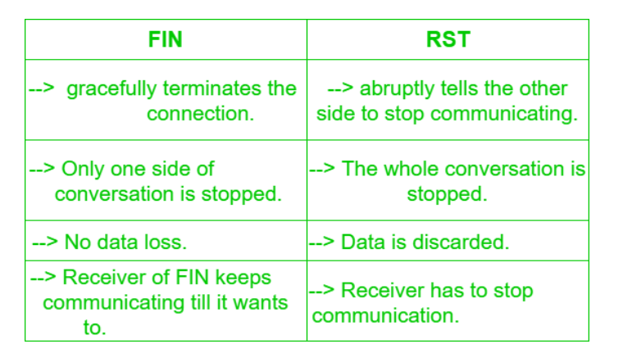
Finish (FIN) v/s Reset (RST) –

Slide 49
Window size :
The field defines the window size of the sending TCP in bytes.
Note that the length of this field is 16 bits, which means that the maximum size of the window is 65535 bytes.
This value is normally referred to as the receiving window ( rwnd ) and is determined by the receiver.
The sender must obey the dictation of the receiver in this case.
Checksum :
This 16-bit field contains the checksum.
The calculation of the checksum for TCP. ( follows the same procedure as the one described for UDP)

Slide 50
Urgent pointer :
This 16-bit field, which is valid only if the urgent flag is set, is used when the segment contains urgent data.
The number is added to the sequence number to obtain the number of the last urgent byte in the data section of the segment.
Options :
There can be up to 40 bytes of optional information in the TCP header.
Encapsulation :
A TCP segment encapsulates the data received from the application layer.
The TCP segment is encapsulated in an IP datagram, which in turn is encapsulated in a frame at the data-link layer as shown below :

Slide 51
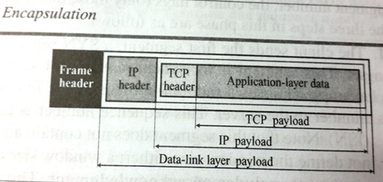

Slide 52
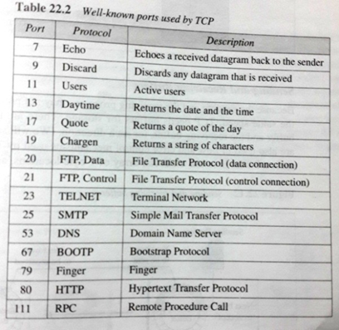
Port Numbers :
Table lists some well-known port numbers used by TCP.

Slide 53
A TCP Connection
Connection Establishment
Data Transfer
Connection Termination

Slide 54
Connection Establishment
TCP transmits data in full duplex mode.
Three-Way Handshake
  Server program tells its TCP that it is ready to accept a connection. This request is called a passive open.
  The client program issues a request for an active open.

Slide 55
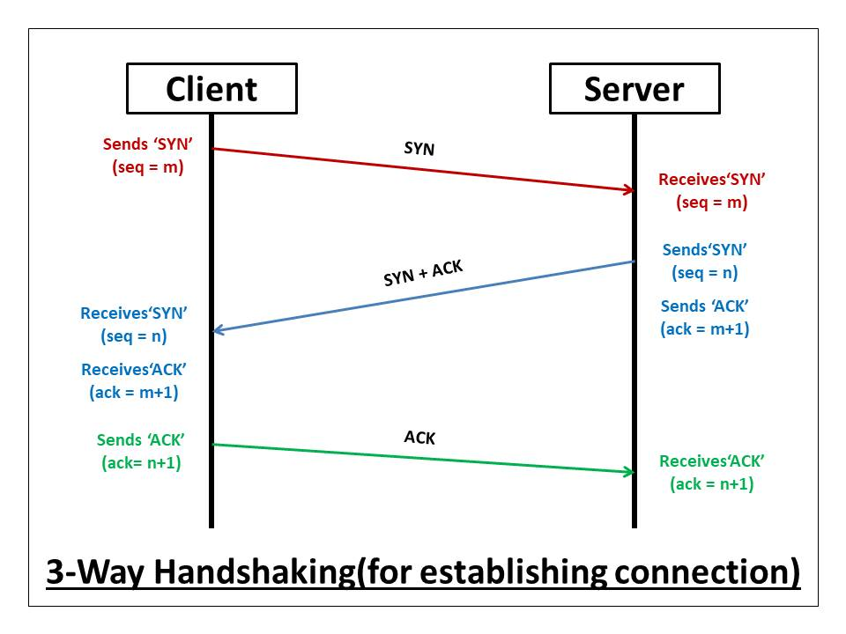
Connection Establishment in TCP -3 way handshaking

Slide 56
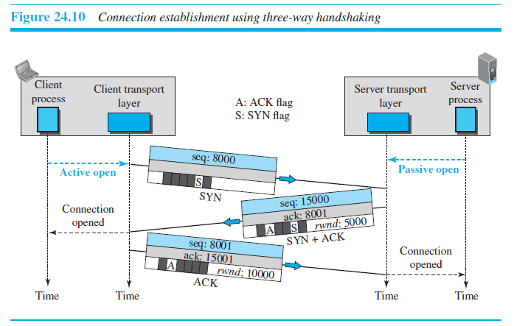
Connection Establishment

Slide 57
Connection Establishment
The client sends the first segment, a SYN segment
  Only the SYN flag is set.
  This segment is for synchronization of sequence numbers
  segment does not contain an acknowledgment number
  Does not define window size.
  SYN segment cannot carry data, but it consumes one sequence number ( for one imaginary byte).

Slide 58
Connection Establishment
Server sends the second segment, a SYN + ACK.
This segment has a dual purpose:
  SYN segment for communication in the other direction(initialize a sequence number for numbering the bytes sent from the server to the client).
  The server also acknowledges the receipt of the SYN segment from the client by setting ACK flag.
Because segment contains an ACK, it also need to define window size, rwnd(to be used by client).
A SYN + ACK segment cannot carry data, but it does consume one sequence number.

Slide 59
Connection Establishment
The client sends the third segment – an ACK segment.
An ACK segment, if carrying no data, consumes no sequence number.

Slide 60
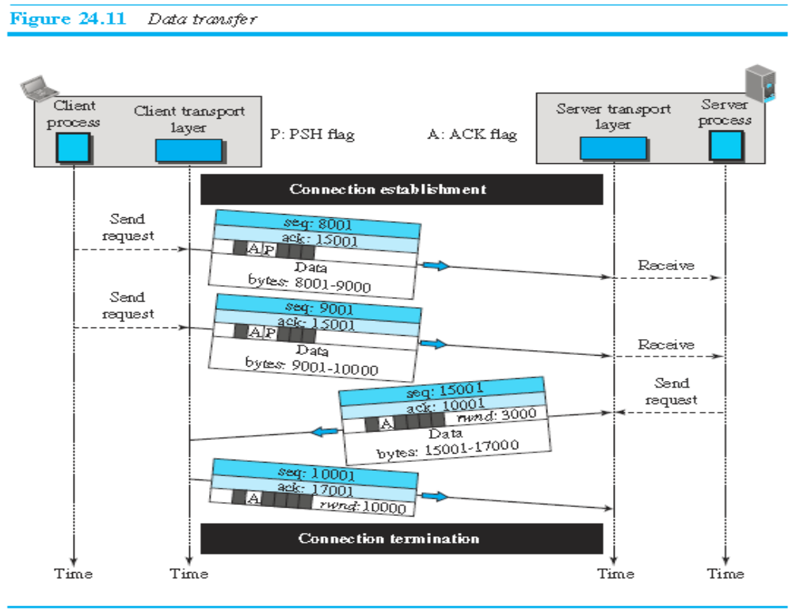
Data Transfer

Slide 61
Data Transfer
After connection establishment, bidirectional data transfer can take place.
acknowledgment can be piggybacked with the data.
Pushing Data:
  Delayed transmission and delayed delivery of data may not be acceptable by the application program.
  application program at the sender can request a push operation
  TCP can choose whether or not to use this feature.

Slide 62
Data Transfer
After connection establishment, bidirectional data transfer can take place
Urgent Data :
  Each byte of data has a position in the stream. However, there are occasions in which an application program needs to send urgent bytes
  send a segment with the URG bit set.
  Sending TCP send a segment with the URG bit set.
  Sending TCP creates a segment and inserts the urgent data at the beginning of the segment, rest segment can carry normal data.
  The urgent pointer field in the header defines the end of the urgent data (the last byte of urgent data).

Slide 63
Urgent Flag/Pointer
For example, if the segment sequence number is 15000 and the value of the urgent pointer is 200, the first byte of urgent data is the byte 15000 and the last byte is the byte 15200. The rest of the bytes in the segment (if present) are non-urgent.

Slide 64
Connection Termination
Either of client or server can close the connection, usually initiated by the client.
Most implementation allow two options:
  Three way handshaking
  Four way handshaking with Half-close option.

Slide 65
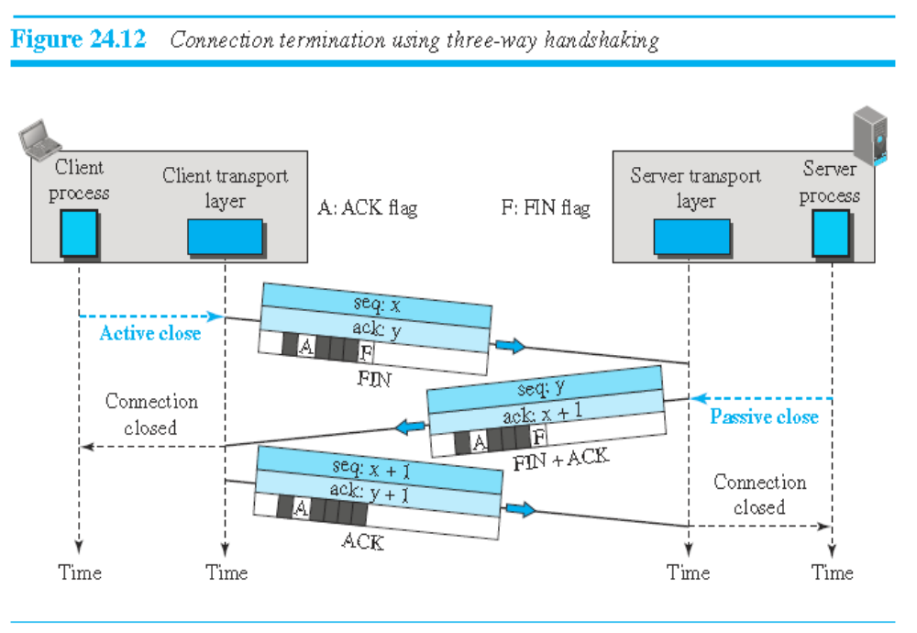
Connection Termination

Slide 66
Connection Termination
I. Three Way Handshake :
Client TCP sends a FIN segment in which FIN flag is set.
FIN segment can include the last chunk of data sent by the client or it can be just a control segment.
The FIN segment consumes one sequence number if it does not carry data.

Slide 67
Connection Termination
II. Three Way Handshake :
Server TCP, after receiving FIN segment sends a FIN+ACK segment to confirm receipt of FIN segment and also to announce closing of connection in other direction.
This segment can also carry last chunk of data from server.
If it does not carry data, it consumes only one sequence number because it needs to be acknowledged.

Slide 68
Connection Termination
III. Three Way Handshake :
Client TCP sends the last segment, an ACK segment, to confirm the receipt of the FIN segment from the TCP server.
This segment cannot carry data and consumes no sequence numbers

Slide 69
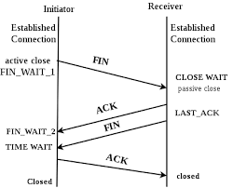
Connection Termination in TCP

Slide 70
Flow Control :
Flow control defines the amount of data a source can send before receiving an acknowledgment from the destination.
In extreme case, a transport-layer protocol could send 1 byte of data and wait for an acknowledgment before sending the next byte.
But this would be an extremely slow process. If the data are travelling a long distance, the source is idle, while it waits for an acknowledgment.
At the other extreme, a transport-layer protocol can send all the data it has without worrying about acknowledgment.
This speeds up the process, but it may overwhelm the receiver.
Besides, if some part of the data is lost, duplicated, received out of order, or corrupted, the source will not know until all data have been checked by the destination.
TCP has a solution that stands somewhere in between.
It defines a window that is imposed on the buffer of data delivered from the application program and is ready to be sent.
TCP sends as many data as are defined by the sliding window protocol.

Slide 71
Flow control PROTOCOLS
Stop and wait
Sliding window protocols:
  Go back N
  Selective Repeat

Slide 72
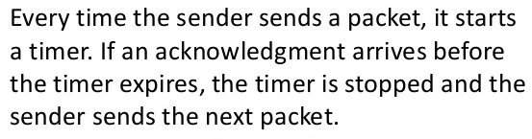
Stop-and-Wait Protocol

Slide 73
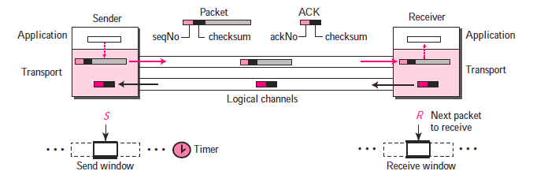
Stop-and-Wait Protocol
Flow control is achieved by forcing the sender to wait for an ACK
Error Control is achieved by discarding corrupted packets and letting the sender resend unacknowledged packets when the timer expires

Slide 74
Stop-and-Wait Protocol
Sequence Numbers:
  To prevent duplicate packets, the protocol uses sequence numbers and acknowledgement numbers
  Range of sequence number?
  Assume ‘x’ as sequence number then we only need to use ‘x+1’ after that. There is no need for x+2
  Eg: Packet number ‘0’ is sent from the sender and receivers receives it successfully then an ack 1 is generated by receiver
  If Packet 0 is lost or corrupted; after time out sender will again send packet 0
  So in all we have only 2 numbers 0 and 1

Slide 75
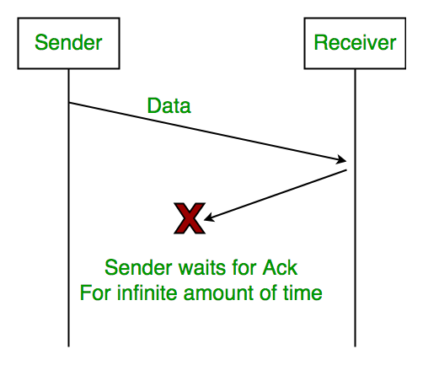
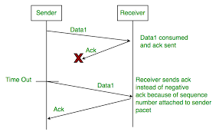
Drawback -Stop and wait
Sends one frame at a time-slower(no pipelining)

Slide 76
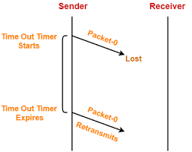

Slide 77
Pipelining:
Pipelining:
  A task is often begun before the previous task has ended, in networking
  This is known as pipelining
  There is no pipelining in Stop-and-wait protocol
  However pipelining is used in next two protocols because several packets can be sent before a sender receive feedback about the previous packets

Slide 78
Drawback – Poor utilization of bandwidth
Assume that, in a Stop-and-Wait system, the bandwidth of the line is 1Mbps, and 1bit takes 20 milliseconds to make a round trip. What is bandwidth delay product? If the system data packets are 1,000 bits in length, what is the utilization percentage of the link?
Solution:
B.W * Delay=1M*20m=20,000 bits
The system can send 20,000 bits during the time it takes for the data to go from the sender to the receiver and the ack to comeback. However system send only 1000 bits.
Utilization %= 1000/20000=5 %
Hence link capacity is wasted

Slide 79
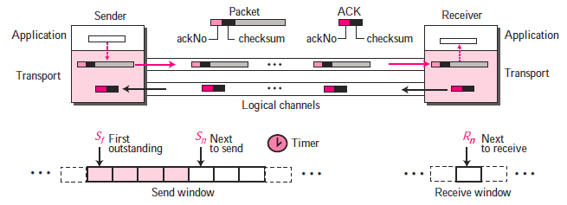
Go-Back-N Protocol
Notes:
The key to Go-back-N is that we can send several packets before receiving acknowledgments, but the receiver can only buffer one packet. We keep a copy of the sent packets until the acknowledgments arrive. Acknowledgment number in this protocol is cumulative and defines the sequence number
of the next packet expected. For example, if the acknowledgment number (ackNo) is 7, it means all packets with sequence number up to 6 have arrived, safe and sound, and the receiver is expecting the packet with sequence number 7.

Slide 80
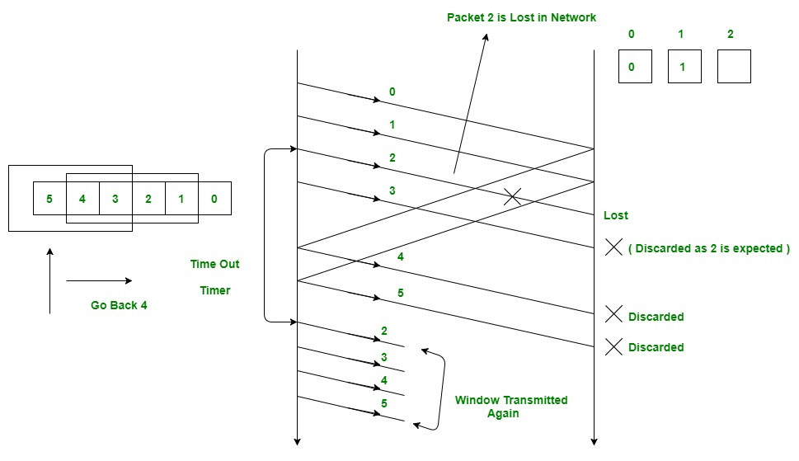
Go-Back-N Protocol
https://www.youtube.com/watch?v=LnbvhoxHn8M

Slide 81
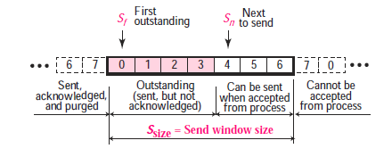
Send window for Go-Back-N
S_{f} (send window, the first outstanding packet)
S_{n}(send window, the next packet to be sent)
Notes:
The send window at any time divides the possible sequence numbers into four regions. The first region, left of the window, defines the sequence numbers belonging to packets that are already acknowledged. The sender does not worry about these packets and keeps no copies of them. The second region, colored, defines the range of sequence numbers belonging to the packets that are sent, but have an unknown status. The sender needs to wait to find out if these packets have been received or were lost. We call these outstanding packets. The third range, white in the figure, defines the range of sequence
numbers for packets that can be sent; however, the corresponding data have not yet been received from the application layer. Finally, the fourth region, right of the window, defines sequence numbers that cannot be used until the window slides.

Slide 82
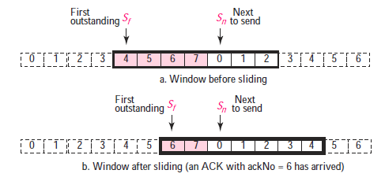
Sliding the send window

Slide 83
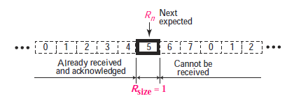
Receive window for Go-Back-N
Notes:
The receive window makes sure that the correct data packets are received and that the correct acknowledgments are sent. In Go-back-N, the size of the receive window is always 1. The receiver is always looking for the arrival of a specific packet. Any packet arriving out of order is discarded and needs to be resent. The sequence numbers to the left of the window belong to the packets already received and acknowledged; the sequence numbers to the right of this window define the packets that cannot be received. Any received packet with a sequence number in these two regions is discarded. Only a packet with a sequence number matching the value of Rn is accepted and acknowledged. The receive window also slides, but only one slot at a time.

Slide 84
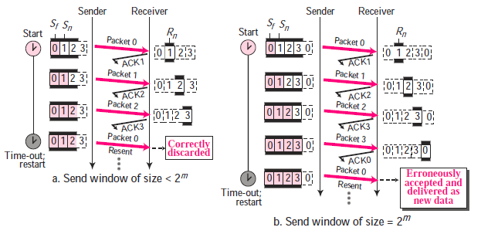
In the Go-Back-N protocol, the size of the send window must be less than 2^{m}

Slide 85
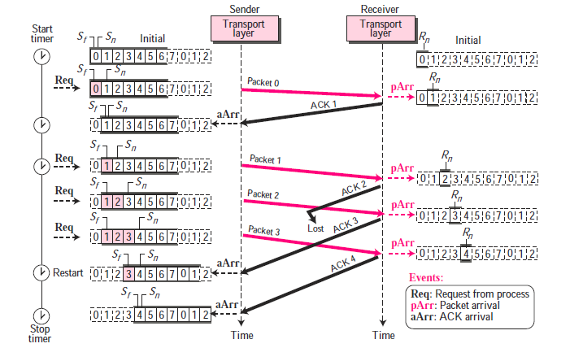
Notes:
This is an example of a case where the forward channel is reliable, but the reverse is not. No data packets are lost, but some ACKs are delayed
and one is lost. The example also shows how cumulative acknowledgments can help if acknowledgments are delayed or lost. After initialization, there are some sender events. Request events are triggered by message chunks from the application layer; arrival events are triggered by ACK received from the network layer. There is no time-out event here because all outstanding packets are acknowledged before the timer expires. Note that although ACK 2 is lost, ACK 3 is cumulative and serves as both ACK 2 and ACK 3. There are four events at the receiver site.

Slide 86
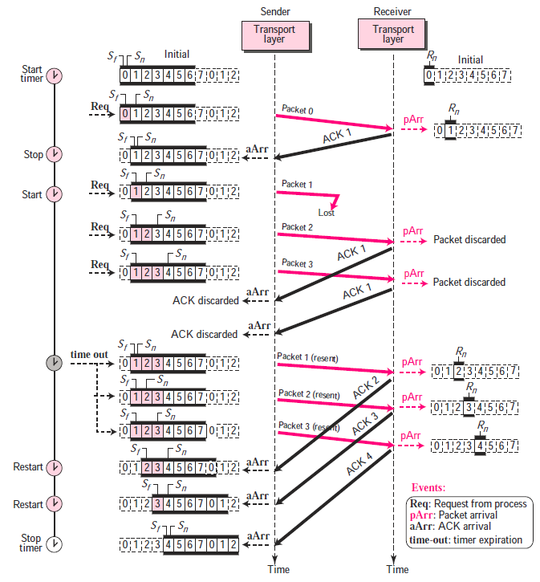
Notes:
Packets 0, 1, 2, and 3 are sent. However, packet 1 is lost. The receiver receives packets 2 and 3, but they are discarded because they are received out of order (packet 1 is expected). When the receiver receives packets 2 and 3, it sends ACK1 to show that it expects to receive packet 1. However, these ACKs are not useful for the sender because the ackNo is equal Sf, not greater that Sf. So the sender discards them. When the time-out occurs, the sender resends packets 1, 2, and 3, which are acknowledged.

Slide 87
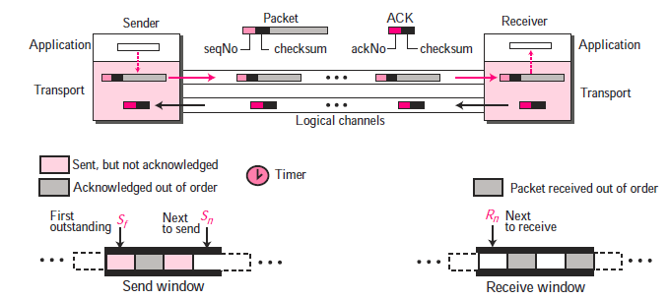
Selective-Repeat Protocol
Notes:
The Go-Back-N protocol simplifies the process at the receiver. The receiver keeps track of only one variable, and there is no need to buffer out-of-order packets; they are simply discarded. However, this protocol is inefficient if the underlying network protocol loses a lot of packets. Each time a single packet is lost or corrupted, the sender resends all outstanding packets although some of these packets may have been received safe and sound, but out of order. If the network layer is losing many packets because of congestion in the network, the resending of all of these outstanding packets makes the congestion
worse, and eventually more packets are lost. This has an avalanche effect that may result in the total collapse of the network.

Slide 88
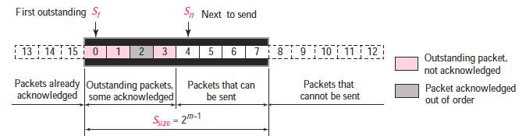
Send window for Selective-Repeat protocol
Check for the window size here!!!

Slide 89
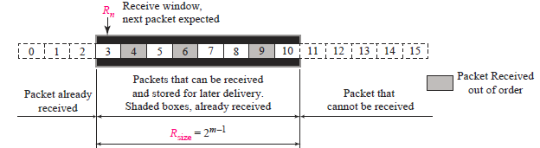
Receive window for Selective-Repeat protocol

Slide 90
Transmission
Control Protocol
Notes:
TCP/IP Forousan 4th edition

Slide 91
Sliding Window Protocol:
TCP uses a sliding window protocol.
With this method, both hosts use a window for each connection.
The window spans a portion of the buffer containing bytes that a host can send before worrying about an acknowledgment from the other host.
The window is called a sliding window, because it can slide over the buffer as data and acknowledgments are sent and received.

Slide 92
A sliding window is used to make transmission more efficient as well as to control the flow of data so that the destination does not become overwhelmed with data.
TCP’s sliding windows are byte oriented.
Sender Buffer :
Figure shows the sender buffer in flat buffer for simplicity.
If the two ends are connected, it forms a circular buffer.
In the given figure, the bytes before 200 have been sent and acknowledged.
The sender can reuse these locations.
Bytes 200 to 202 have been sent, but not acknowledged.
The sender has to keep these bytes in the buffer in case they are lost or damaged.
Bytes 203 to 211 are in the buffer (produced by the process) but have not yet been sent.

Slide 93
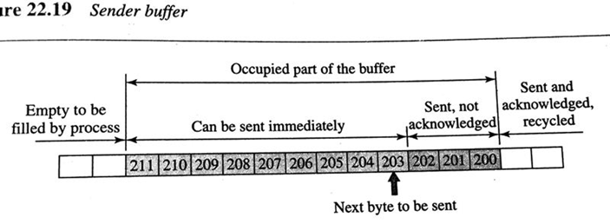

Slide 94
Let us examine the situation in which there is no sliding window protocol.
In this case, the sender can go ahead and send all the bytes (up to 211 ) in its buffer, without regard to the condition of the receiver.
The receiver’s buffer, with its limited size could completely fill up because the receiving process is not consuming data fast enough.
The excess bytes discarded by the receiver will require retransmission.
The sender must adjust itself to the number of locations available at the receiver site.

Slide 95
Receiver Window :
The figure shows the receiver buffer.
Note that the next byte to be consumed by the process is byte 164.
The receiver expects to receive byte 200 from the sender ( which has been sent but not received ).
How many more bytes can the receiver store ?
If the total size of the receiving buffer is N and M locations are already occupied, then only N-M more bytes can be received.
This value is called the receiver window.
For example, if N=13 and M=6, this means that the value of the receiver window is 7.

Slide 96
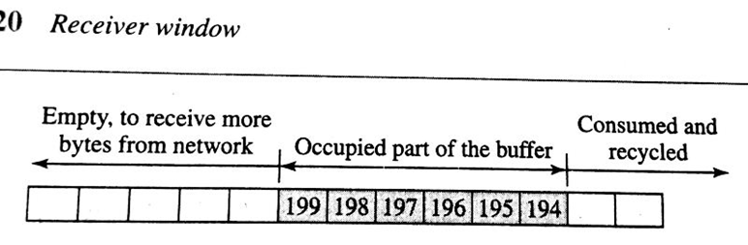

Slide 97
Error Control :
TCP is a reliable transport-layer protocol.
This means that an application program that delivers a stream of data to TCP relies on TCP to deliver the entire stream to the application program on the other end in order, without error, and without any part lost or duplicated.
Errors control in TCP includes mechanisms for detecting corrupted segments, lost segments, out of order segments.
TCP uses three simple tools : checksum, acknowledgment, and time-out.
Each segment includes the checksum field, which is used to check for a corrupted segment.
If the segment is corrupted, it is discarded by the destination TCP.
TCP uses the acknowledgment method to confirm the receipt of those segments that have reached the destination uncorrupted. No negative acknowledgment is used in TCP.
If a segment is not acknowledged before the time out, It is considered to be either corrupted for lost.

Slide 98
Congestion Control and Quality of Service :
These two issues are so closely bound together that improving one means improving the other and ignoring one usually means ignoring the other.
These issues are not only related to one layer, but to three :
the data link layer, the network layer, and the transport layer.

Slide 99
Data Traffic:
The main focus of congestion control and quality of service is data traffic.
In congestion control we try to avoid traffic congestion.
In quality of service, we try to create an appropriate environment for the traffic.
So, before talking about congestion control and quality of service, data traffic should be discussed.
The Average Rate is the number of bits sent during a period to time, divided by the number of seconds in that period.
Average data rate = amount data / time.
The average data rate is very useful characteristic of traffic, because it indicates the average bandwidth needed by the traffic.

Slide 100
Congestion :
It is an important issue in a packet-switched network.
It may occur, if the load on the network – the number of packets sent to the network – is greater than the capacity of the network – the number of packets a network can handle.
Congestion control refers to the mechanisms and techniques to control the congestion and keep the load below the capacity.

Slide 101
What are the reasons for the congestions in a network ?
Congestions happens in any system that involves waiting.
For eg, congestion happens on a freeway because any abnormality in the flow, such as an accident during rush hour, creates blockage.
Congestions in a network or internetwork occurs because routers and switches have queues - buffers that hold the packets before and after processing .
A router, for example, has an input queue and an output queue for each interface.
When a packet arrives at the incoming interface, it undergoes three steps before departing.

Slide 102
1. The packet is put at the end of the input queue while waiting to be checked.
2. The processing module of the router removes the packet from the input queue once it reaches the front of the queue and uses its routing table and the destination address to find the route.
3. The packet is put in the appropriate output queue and waits its turn to be sent.
It needs to be aware of two issues : First, if the rate of packet arrival is higher than the packet processing rate, the input queues become longer and longer.
Second, if the packet departure rate is less than the packet processing rate, the output queues become longer and longer.

Slide 103
Network Performance :
Congestion control involves two factors that measure the performance of a network delay and throughput ( throughput in a network is the number of packets passing through the network in a unit of time ).

Slide 104
Congestion Control :
It refers to techniques and mechanisms that can either prevent congestion, before it happens, or remove congestion, after it has happened.
It can be classified under two broad categories :
Open-loop congestion control ( prevention ) and
Closed-loop congestion control ( removal ).

Slide 105
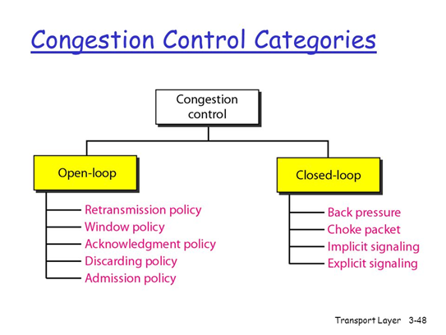

Slide 106
Open-loop congestion control ( prevention ) :
These policies are applied to prevent congestion before it happens. In these, congestions is handled by either the sourced or the destination.
1. Retransmission policy : A good retransmission policy can prevent congestion.
2. Window Policy : The type of window at the sender may also affect congestion. The Selective Repeat window is better than the Go-Back-N window for congestion control.

Slide 107
3. Acknowledgment Policy : If the receiver does not acknowledge every packet it receives, it may slow down the sender and help prevent congestion.
4. Discarding Policy : A good discarding policy by the routers may prevent congestion and at the same time may not harm the integrity of the transmission. Eg. In audio transmission, if the policy is to discard less sensitive packets when congestion is likely to happen, the quality of sound is still preserved and congestion is prevented.
5. Admission Policy : An admission policy which is a quality-of-service mechanism, can also prevent congestion in virtual-circuit networks. Switches in a flow first check the resource requirement of a flow before admitting it to the network.

Slide 108
Closed-loop congestion control ( removal ).
Closed loop congestion control mechanisms try to alleviate congestion after it happens. Several mechanisms have been used by different protocols. They are :
1. Back Pressure : When a router is congested, it can inform the previous upstream router to reduce the rate of outgoing packets. The action can be recursive all the way to the router before the source. This mechanism is called back pressure. { [ The further routers may be congested ( it may have large data to handle ), so it informs the previous routers to slow down the output flow of data. It continues up to the source machine. This process is the back pressure ]. So the pressure on the last router is moved backward to the source to remove the congestion. It was implemented in first virtual-circuit network, X.25. It cannot be implemented in a datagram network because in this type of network a node (router) does not have the slightest knowledge of the upstream router. }

Slide 109
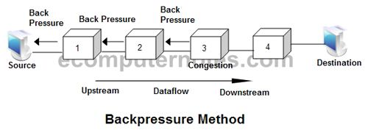

Slide 110
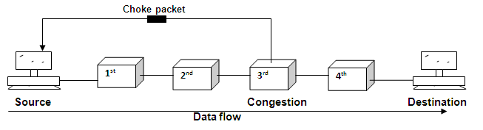
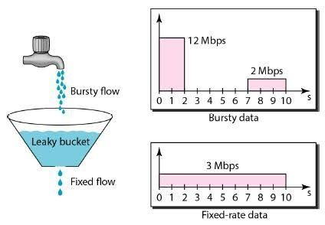

Slide 111
2. Choke Point : It is a packet sent by a router to the source to inform it of congestion. This type of control is similar to ICMP’s source quench packet.
3. Implicit Signaling : The source can detect an implicit signal concerning congestion and slow down its sending rate. [ the delay in receiving an acknowledgment can be a signal that the network is congested.].
4. Explicit signaling : The routers that experience congestion can send an explicit signal, the setting of a bit in a packet, to inform the sender or the receiver of congestion.

Slide 112
5. Backward Signaling : the bit can be set in a packet moving in the direction opposite to the congestion. This bit can warn the source that there is congestion and that it needs to slow down to avoid the discarding of packets.
6. Forward Signaling : This bit be set in the packet moving in the direction of the congestion. This bit can warn the destination that there is congestion. The receiver in this case can use policies, such as slowing down the acknowledgment, to alleviate (reduce / ease / relive) the congestion.

Slide 113
Congestion Control in TCP :
An internet is a combination of networks and connecting devices (routers). A packet from a sender may pass through several routers before reaching its final destination. A router has a buffer that stores the incoming packets, processes them, and forwards them. If a router receives packets faster than it can process, congestion might occur and some packets could be dropped. When a packet does not reach the destination, no acknowledgment is sent for it. The sender has no choice but to retransmit the lost packet. This may create more congestion and more dropping of packets, which means more retransmission and more congestion. A point may then be reached in which the whole system collapses and no more data can be sent. TCP therefore needs to find some way to avoid this situation.

Slide 114
TCP assumes that the cause of a lost segment is due to congestion in the network.
During the flow control, when the receiver is overwhelmed with data, we said that that the sender window is determined by the available buffer space in the receiver. We assumed that it is only the receiver that can dictate to the sender the size of the sender’s window. We have totally ignored the other entity – the network. If the network cannot deliver the data as fast as they are created by the sender, it needs to tell the sender to slow down. In other words, in addition to the receiver, the network is a second entity that determines the size of the senders window in TCP.
If the cause of the lost segment is congestion, retransmission of the segment does not remove the cause – it aggravates it.

Slide 115
QUALITY OF SERVICE [ QoS] : It is internetworking issue that has been discussed more than defined. It can be defined as something a flow seeks to attain.
Flow Characteristics : There are four types of characteristics attributed to aflow : reliability, delay, jitter, and bandwidth.
Reliability : It is a characteristics that a flow needs. Lack of reliability means losing a packet or acknowledgement, which entails retransmission. However the sensitivity of application programs to reliability is not the same.

Slide 116
Delay : Source to Destination delay is another flow characteristic. Again application can tolerate delay in different degrees. In this case telephony audio conferencing, video conferencing, and remote log-in need minimum delay, while delay in file transfer of e-mail is less important.
Jitter: It is the variation in delay for packets belonging to the same flow. Eg. For application like audio and video, if four packets are sent at times 0, 1, 2, 3 and they arrive at 20, 21, 22, 23, all have the same delay time of 20 unites of time. On the other hand, if the above four packets arrive at 21, 23, 21, 28 units of time, they have different delays of 21, 22, 19, 25. The first case is completely acceptable; the second case is not. For this application it doesn’t matter, whether the delay is short or long, but with same delay for all packets. So the second one is not acceptable.
Jitter is defined as the variation in the packet delay. High jitter means the difference between delays is large; low jitter means the variation is small.

Slide 117
Bandwidth : Different applications need different bandwidth. In video conferencing we need to send millions of bits per second to refresh a color screen while the total number of bits in an email may not reach even a million.
Flow Classes : Based on the flow characteristics, we can classify flows into groups, with each group having similar levels of characteristics. ATM (Asynchronous Transfer Mode ) Forum defines four services : CBR (constant-bit-rate), VBR (variable-bit-rate), ABR (available-bit-rate), UBR (unspecified-bit-rate).

Slide 118
TECHNIQUES TO IMPROVE QoS : Four common methods .
1. Scheduling : Packets from different flows arrive at a switch or router for processing. A good scheduling technique treats the different flows in a fair and appropriate manner. Some of the scheduling techniques are given below:
1. FIFO Queuing : In First-in, First-out (FIFO) queuing, packets wait in a buffer (queue) until the node (router or switch) is ready to process them. If the average arrival rate is higher than the average processing rate, the queue will fill up and new packets will be discarded.

Slide 119
2. Priority Queuing: Packets are assigned to a priority class. Each priority class has its own queue. The packets in the highest-priority queue are processed first. Packets in the lowest-priority queue are processed last. Note that the system does not stop serving a queue until it is empty. It can provide better QoS than FIFO queuing.
3. Weighted Fair Queuing : In this technique, the packets are still assigned to different classes are admitted to different queues. The queues are weighted based on the priority of the queues.

Slide 120
2. Traffic Shaping : It’s a mechanism to control the amount and the rate of the traffic sent to the network. LEAKY BUCKET : The input rate can vary, but the output rate remains constant.
3. Resource Reservation : A flow of data needs resources such as a buffer, bandwidth, CPU time, and so on. The QoS is improved if these resources are reserved beforehand.

Slide 121
4. Admission Control : It refers to the mechanism used by a router, or a switch, to accept or reject a flow based on predefined parameters called flow specification. Before a router accepts a flow for processing, it checks the flow specifications to see if its capacity ( in terms of bandwidth, buffer size, CPU speed, etc.) and its previous commitments to other flows can handle the new flow.

